Slide 1
MANAGING A HOLISTIC MARKETING ORGANIZATION FOR THE LONG RUN

Slide 2
Learning Objectives
What are important trends in marketing practices?
What are the keys to effective internal marketing?
How can companies be socially responsible marketers?
What tools are available to help companies monitor and improve their marketing activities?
What do marketers need to do to succeed in the future?

Slide 3
Trends in
Marketing Practices
Reengineering
Outsourcing
Benchmarking
Supplier partnering
Customer partnering
Merging
Globalizing
Flattening
Focusing
Justifying
Accelerating
Empowering
Broadening
Monitoring
Uncovering
Notes:
With globalization, deregulation, market fragmentation, consumer empowerment, environmental concerns, and all the remarkable developments in communication technology, the world has unquestionably become a very different place for marketers. Table 23.1 summarizes some important shifts in marketing realities.
Reengineering. Appointing teams to manage customer-value-building processes and break down walls between departments.
Outsourcing. Buying more goods and services from outside domestic or foreign vendors.
Benchmarking. Studying “best practice companies” to improve performance.
Supplier partnering. Partnering with fewer but better value-adding suppliers.
Customer partnering. Working more closely with customers to add value to their operations.
Merging. Acquiring or merging with firms in the same or complementary industries to gain economies of scale and scope.
Globalizing. Increasing efforts to “think global” and “act local.”
Flattening. Reducing the number of organizational levels to get closer to the customer.
Focusing. Determining the most profitable businesses and customers and focusing on them.
Justifying. Becoming more accountable by measuring, analyzing, and documenting the effects of marketing actions.
Accelerating. Designing the organization and setting up processes to respond more quickly to changes in the environment.
Empowering. Encouraging and empowering personnel to produce more ideas and take more initiative.
Broadening. Factoring the interests of customers, employees, shareholders, and other stakeholders into the activities of the enterprise.
Monitoring. Tracking what is said online and elsewhere and studying customers, competitors, and others to improve business practices.
Uncovering. Using data mining and other analytical methods to develop deep insights into customers and how they behave.

Slide 4
Internal Marketing
Internal marketing requires that everyone in the organization accept the concepts and goals of marketing and engage in identifying, providing, and communicating customer value
Notes:
in a networked enterprise, every functional area can interact directly with customers. Marketing no longer has sole ownership of customer interactions; it now must integrate all the customer-facing processes so customers see a single face and hear a single voice when they interact with the firm.

Slide 5

Organizing the Marketing Department
Functional organization
Geographic organization
Product- or brand-management organization
Market-management Organization
Matrix-management Organization
Notes:
Modern marketing departments can be organized in a number of different, sometimes overlapping ways: functionally, geographically, by product or brand, by market, or in a matrix.
Functional Organization In the most common form of marketing organization, functional specialists report to a marketing vice president who coordinates their activities.
Geographic Organization A company selling in a national market often organizes its sales force (and sometimes its marketing) along geographic lines. The national sales manager may supervise four regional sales managers, who each supervise six zone managers, who in turn supervise eight district sales managers, who each supervise 10 salespeople. Some companies are adding area market specialists (regional or local marketing managers) to support sales efforts in high-volume markets.
Product- or Brand-Management Organization Companies producing a variety of products and brands often establish a product- (or brand-) management organization. This does not replace the functional organization but serves as another layer of management. A group product manager supervises product category managers, who in turn supervise specific product and brand managers.
Market-Management Organization When customers fall into different user groups with distinct buying preferences and practices, a market-management organization is desirable. Market managers supervise several market-development managers, market specialists, or industry specialists and draw on functional services as needed. Market managers of important markets might even have functional specialists reporting to them.
Matrix-Management Organization Companies that produce many products for many markets may adopt a matrix organization employing both product and market managers.

Slide 6
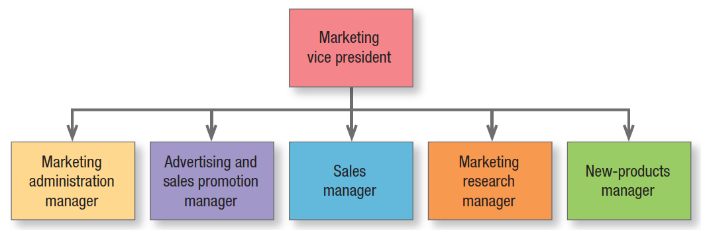
Functional Organization
Notes:
Figure 23.1 shows five specialists. Others might include a customer service manager, a marketing planning manager, a market logistics manager, a direct marketing manager, and a digital marketing manager.

Slide 7
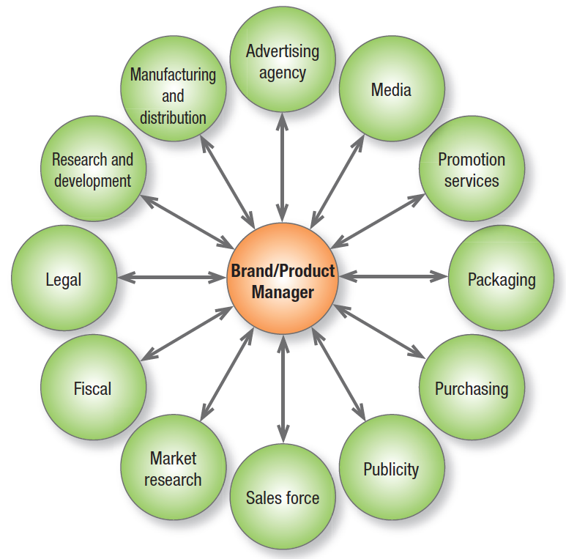
HUB-AND-SPOKE SYSTEM
Notes:
A product-management organization makes sense if the company’s products are quite different or there are more than a functional organization can handle. This form is sometimes characterized as a hub-and-spoke system. The brand or product manager is figuratively at the center, with spokes leading to various departments representing working relationships (see Figure 23.2).

Slide 8
Brand/Product
Manager Tasks
  Develop long-range/competitive
  strategy
  Prepare marketing plan/sales forecast
Work with agencies
Increase support among sales force
Gather intelligence
Initiate product improvements
Notes:
The product-management organization lets the product manager concentrate on developing a cost-effective marketing program and react more quickly to new products in the marketplace; it also gives the company’s smaller brands a product advocate.

Slide 9
Market-Management Organization
Market-centered organizations
Customer-management organization
Notes:
Market managers are staff (not line) people, with duties like those of product managers. They develop long-range and annual plans for their markets and are judged by their market’s growth and profitability. Because this system organizes marketing activity to meet the needs of distinct customer groups, it shares many advantages and disadvantages of product-management systems. Many companies are reorganizing along market lines and becoming market-centered organizations. Xerox converted from geographic selling to selling
by industry, as did IBM and Hewlett-Packard.
When a close relationship is advantageous, such as when customers have diverse and complex requirements and buy an integrated bundle of products and services, a customer-management organization, which deals with individual customers rather than the mass market or even market segments, should prevail.

Slide 10
A Creative
Marketing Organization
Shift to customer-focus
Appoint marketing officer & task force
Get outside help
Change reward system
Hire marketing talent
Develop in-house marketing training
Install marketing planning system
Establish annual recognition program
Shift to a process-outcome focus
Empower employees
Notes:
Many companies realize they’re not yet really market and customer driven—they are product and sales driven. Transforming into a true market-driven company requires, among other actions: (1) developing a company-wide passion for customers; (2) organizing around customer segments instead of products; and (3) understanding customers through qualitative and quantitative research. The task is not easy, but the payoffs can be considerable. See “Marketing Insight: The Marketing CEO” for concrete actions a CEO can take to improve marketing capabilities.

Slide 11
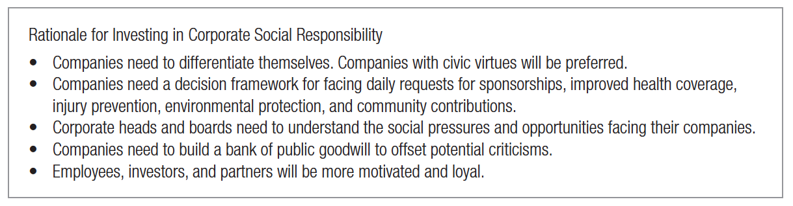
Socially Responsible Marketing
Notes:
Effective internal marketing must be matched by a strong sense of ethics, values, and social responsibility. Taking a more active, strategic role in corporate social responsibility is thought to benefit not just customers, employees, community, and the environment but also shareholders. Firms feel they also benefit in different ways, as Figure 23.4 illustrates.

Slide 12
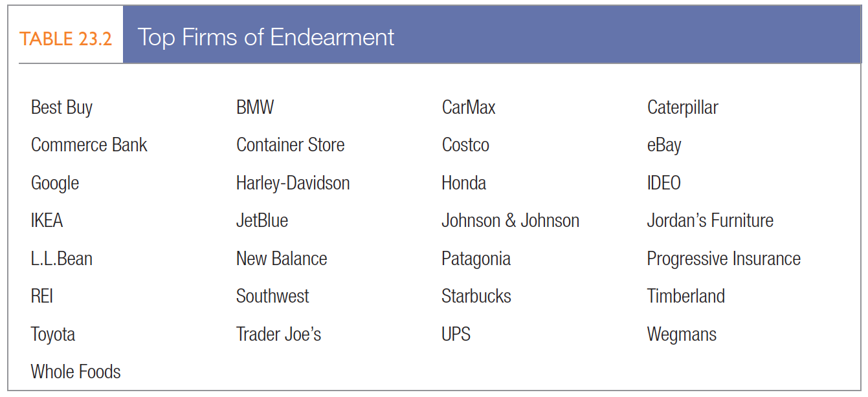
Corporate Social Responsibility
Notes:
Researchers Raj Sisodia, David Wolfe, and Jag Sheth believe humanistic companies make great companies. They see “Firms of Endearment” as those with a culture of caring that serve the interests of their stakeholders, who are defined by the acronym SPICE: Society, Partners, Investors, Customers, and Employees. Sisodia and colleagues believe Firms of Endearment create a love affair with stakeholders. The authors see the 21st-century marketing paradigm as creating value for all stakeholders and becoming a beloved firm. Table 23.2 lists firms receiving top marks as Firms of Endearment from a sample of thousands of customers, employees, and suppliers.

Slide 13
Corporate Social Responsibility
Legal behavior
Ethical behavior
Social responsibility behavior & socially responsible business models
Sustainability & greenwashing
Notes:
Legal Behavior Organizations must ensure every employee knows and observes relevant laws. For example, it’s illegal for salespeople to lie to consumers or mislead them about the advantages of buying a product.
Ethical Behavior Business practices come under attack because business situations routinely pose ethical dilemmas: It’s not easy to draw a clear line between normal marketing practice and unethical behavior. Some issues can generate controversy or sharply divide critics, such as acceptable marketing to children.
Social Responsibility Behavior Marketers must exercise their social conscience in specific dealings with customers and stakeholders. Some top-rated companies for corporate social responsibility are Whole Foods, Walt Disney, Coca- Cola, Johnson & Johnson, and Google. Companies that innovate solutions and values in a socially responsible way are most likely to succeed. Companies such as The Body Shop, Working Assets, and Smith & Hawken are also giving social responsibility a more prominent role, as has Newman’s Own. More firms are coming to believe corporate social responsibility in the form of cause marketing and employee volunteerism programs is not just the “right thing” but also the “smart thing to do.
Sustainability Sustainability—the ability to meet humanity’s needs without harming future generations—now tops many corporate agendas. Major corporations outline in great detail how they are trying to improve the long-term impact of their actions on communities and the environment. Coca-Cola, AT&T, and DuPont have even installed Chief Sustainability Officers. Heightened interest in sustainability has also unfortunately resulted in greenwashing, which gives products the appearance of being environmentally friendly without living up to that promise.

Slide 14
Cause-Related Marketing
Links the firm’s contributions toward a designated cause to customers’ engaging directly or indirectly in revenue-producing transactions with the firm
  Is part of corporate societal marketing (CSM)
Notes:
Many firms blend corporate social responsibility initiatives with marketing activities. Minette Drumwright and Patrick Murphy define CSM as marketing efforts “that have at least one noneconomic objective related to social welfare and use the resources of the company and/or of its partners.” Drumwright and Murphy also include traditional and strategic philanthropy and volunteerism in CSM.

Slide 15
Cause-Related Marketing
Builds brand awareness
Enhances brand image
Elicits brand engagement
Establishes brand credibility
Creates brand community
Evokes brand feelings
Notes:
A successful cause-marketing program can improve social welfare, create differentiated brand positioning, build strong consumer bonds, enhance the company’s public image, create a reservoir of goodwill, boost internal morale and galvanize employees, drive sales, and increase the firm’s market value. Consumers may develop a strong, unique bond with the firm that transcends normal marketplace transactions.

Slide 16
Social Marketing
Social marketing by nonprofits or government organizations furthers a cause
Notes:
Cause-related marketing supports a cause. Social marketing by nonprofit or government organizations furthers a cause, such as “say no to drugs” or “exercise more and eat better.

Slide 17
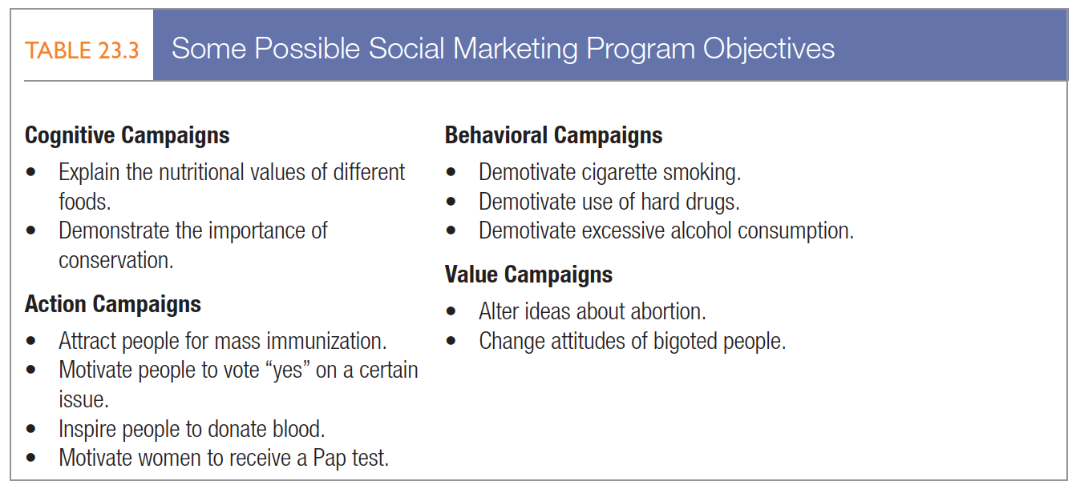
Social Marketing
Notes:
Choosing the right goal or objective for a social marketing program is critical. Should a family-planning campaign focus on abstinence or birth control? Should a campaign to fight air pollution focus on ride sharing or mass transit? Table 23.3 illustrates the range of possible objectives.

Slide 18
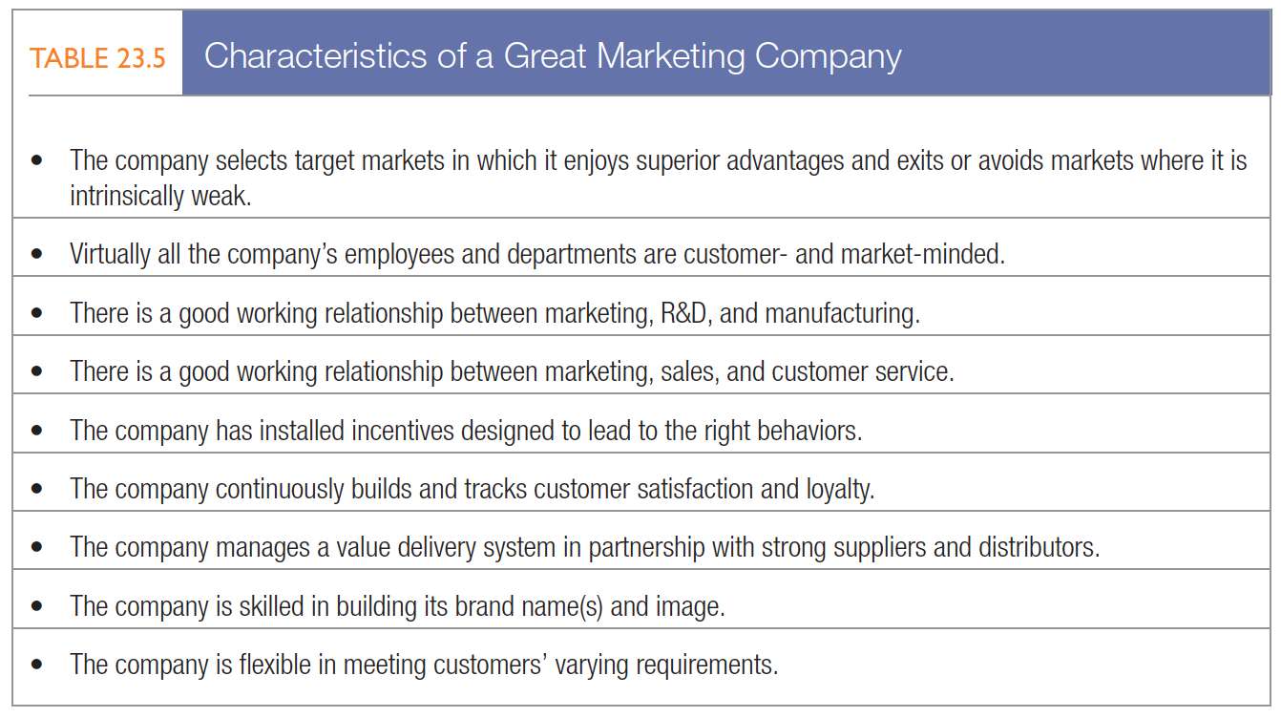
Marketing Implementation/Control
Notes:
Table 23.5 summarizes the characteristics of a great marketing company, great not for what it is but for what it does. Great marketing companies know the best marketers thoughtfully and creatively devise marketing plans and then bring them to life. Marketing implementation and control are critical to making sure marketing plans have their intended results year after year.

Slide 19
Marketing Implementation/Control
Marketing implementation
  The process that turns marketing plans into action assignments and ensures they accomplish the plan’s stated objectives
  Marketing resource management (MRM) software
Notes:
A brilliant strategic marketing plan counts for little if not implemented properly. Strategy addresses the what and why of marketing activities; implementation addresses the who, where, when, and how. They are closely related: One layer of strategy implies certain tactical implementation assignments at a lower level. For example, top management’s strategic decision to “harvest” a product must be translated into specific actions and assignments.
Marketing resource management (MRM) software provides a set of Web-based applications that automate and integrate project management, campaign management, budget management, asset management, brand management, customer relationship management, and knowledge management. The knowledge management component consists of process templates, how-to wizards, and best practices. Software packages can provide what some have called desktop marketing, giving marketers information and decision structures on computer dashboards. MRM software lets marketers improve spending and investment decisions, bring new products to market more quickly, and reduce decision time and costs.

Slide 20
Marketing Implementation/Control
Marketing control
  The process by which firms assess the effects of their marketing activities and programs and make necessary changes and adjustments
Annual Plan Control
Efficiency Control
Profitability Control
Strategic Control
Notes:
Table 23.6 lists four types of needed marketing control: annual-plan control, profitability control, efficiency control, and strategic control.
Annual-Plan Control Annual-plan control ensures the company achieves the sales, profits, and other goals established in its annual plan.
Profitability Control Companies should measure the profitability of their products, territories, customer groups, segments, trade channels, and order sizes to help determine whether to expand, reduce, or eliminate any products or marketing activities.
Efficiency Control. Some companies have established a marketing controller position to work out of the controller’s office but specialize in improving marketing efficiency. These marketing controllers examine adherence to profit plans, help prepare brand managers’ budgets, measure the efficiency of promotions, analyze media production costs, evaluate customer and geographic profitability, and educate marketing staff on the financial implications of marketing decisions.
Strategic Control Each company should periodically reassess its strategic approach to the marketplace with a good marketing audit. Companies can also perform marketing excellence reviews and ethical/social responsibility reviews.

Slide 21
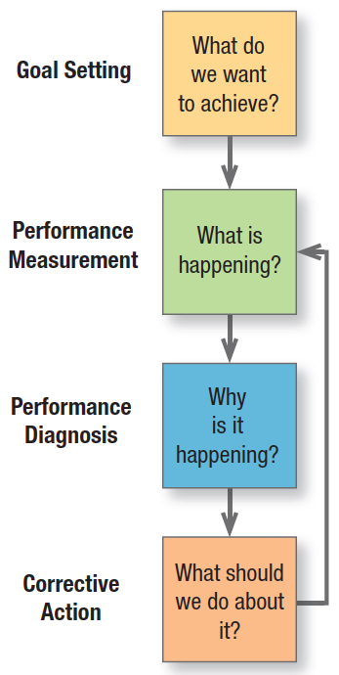
Annual plan control
Marketing metrics
  Sales metrics
  Customer readiness to buy metrics
  Customer metrics
  Distribution metrics
  Communication metrics
Notes:
At its heart is management by objectives (see Figure 23.5). First, management sets monthly or quarterly goals. Second, it monitors performance in the marketplace. Third, management determines the causes of serious performance deviations. Fourth, it takes corrective action to close gaps between goals and performance.
Marketers today have better marketing metrics for measuring the performance of marketing plans (see Table 23.7 for some samples).73 Four tools for the purpose are sales analysis, market share analysis, marketing expense-to-sales analysis, and financial analysis. The chapter appendix outlines them in detail.

Slide 22
Strategic Control
Marketing audit
  A comprehensive, systematic, independent, and periodic examination of a company’s or business unit’s marketing environment, objectives, strategies, and activities, with a view to determining problem areas and opportunities and recommending a plan of action to improve the company’s marketing performance

Slide 23
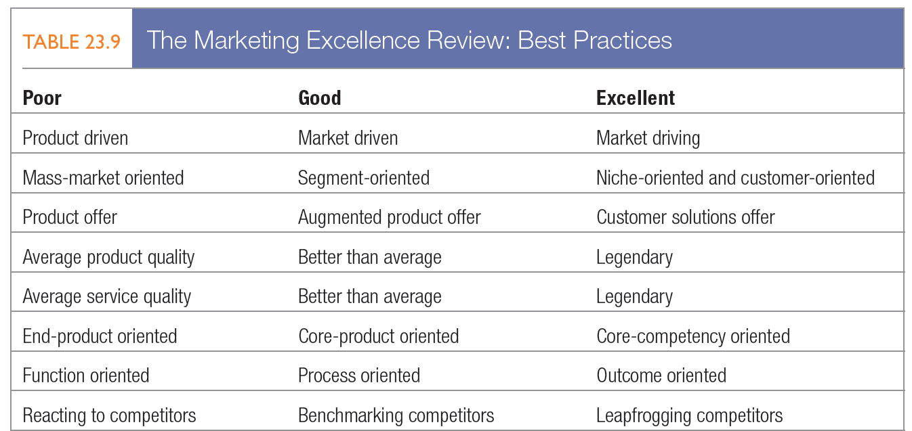
The Marketing Excellence Review
Notes:
The three columns in Table 23.9 distinguish among poor, good, and excellent business and marketing practices. The profile management creates from indicating where it thinks the business stands on each line can highlight where changes could help the firm become a truly outstanding player in the marketplace.

Slide 24
The Future of Marketing
The coming years will see:
  The demise of the marketing department and the rise of holistic marketing
  The demise of free-spending marketing and the rise of ROI marketing
  The demise of marketing intuition and the rise of marketing science
  The demise of manual marketing and the rise of both automated and creative marketing
  The demise of mass marketing and the rise of precision marketing
Notes:
To succeed in the future, marketing must be more holistic and less departmental. Marketers must achieve wider influence in the company, continuously create new ideas, and strive for customer insight by treating customers differently but appropriately. They must build their brands more through performance than promotion. They must go electronic and win through building superior information and communication systems.

Slide 25
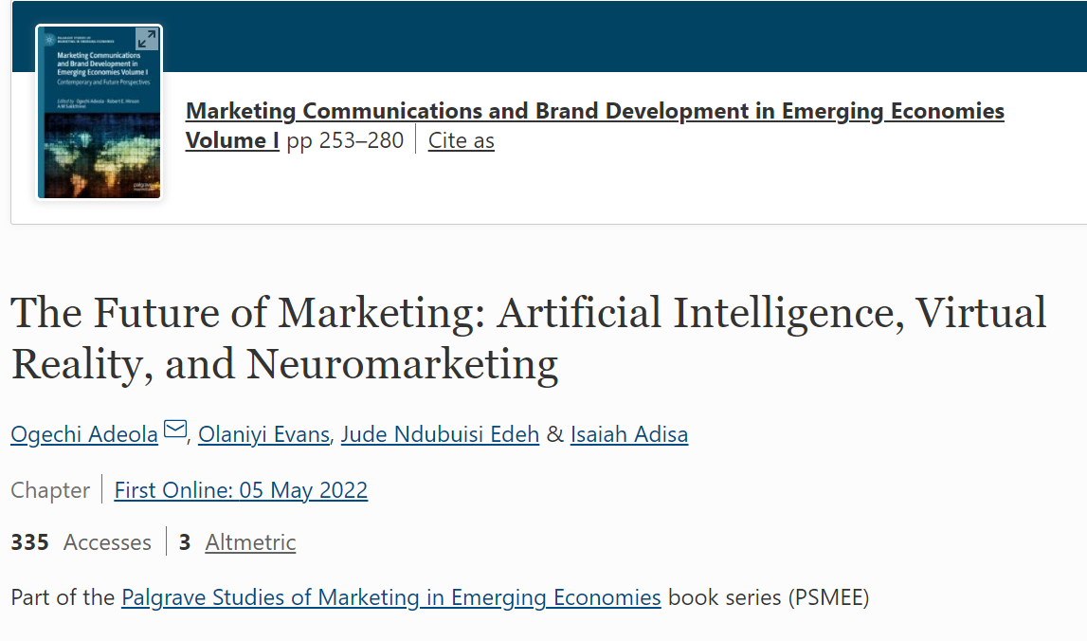
Notes:
To accomplish these changes and become truly holistic, marketers need a new set of skills and competencies listed on this slide.

Slide 26
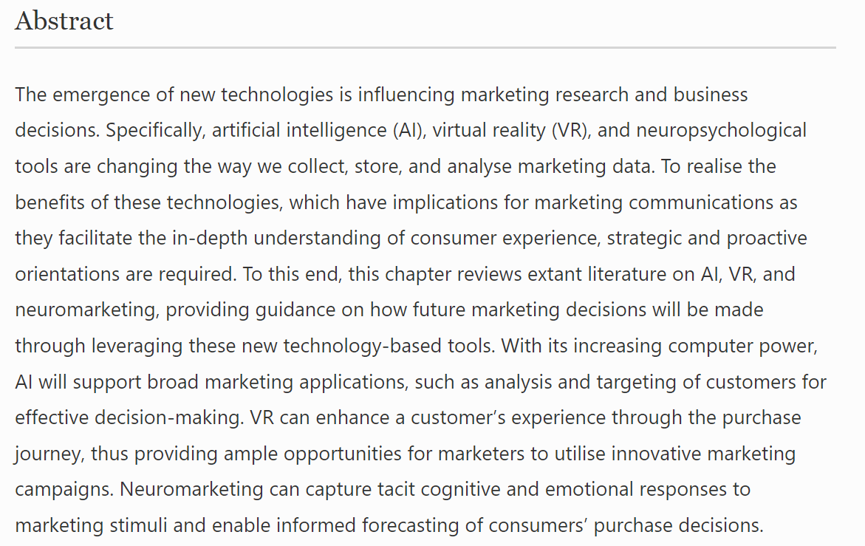
Notes:
To accomplish these changes and become truly holistic, marketers need a new set of skills and competencies listed on this slide.

Slide 27

Any Questions?

